Slide 1
CIS 271 – Web Development 1
JavaScript Objects Notation

Slide 2

JavaScript Object
Object Type: Car
Properties:
Make | Chevvy
currentSpeed | 30mph
color | Black
fuel | gasoline
An object
is an unordered collection of properties. .
An object property
is a name-value pair,
where the name is a string
and the value is any data type.
An object literal (also called an object initializer)
is a comma-separated list of property name and value pairs.

Slide 3
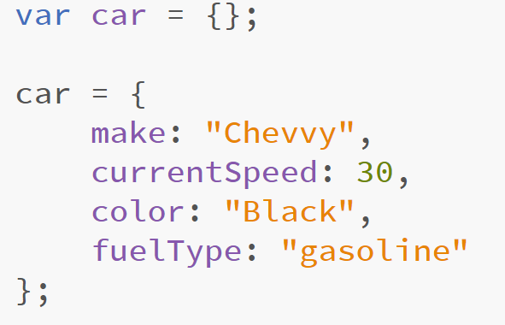
Object example – Literal Notation
Object Type: Car
Properties:
Make | Chevvy
currentSpeed | 30mph
color | Black
fuel | gasoline

Slide 4
JavaScript Object Notation
JavaScript Object Notation - JSON
efficient, structured format for data based on a subset of the JavaScript language.
JSON object
an unordered list of zero or more name/value pairs separated by commas and enclosed within braces { }
JSON array
ordered list of zero or more JSON values separated by commas and enclosed within brackets [ ]

Slide 5
JSON VALUE
JSON value
can be one of six possibilities:
a JSON object,
a JSON array,
a string,
a number,
a boolean (true, false),
or null.

Slide 6
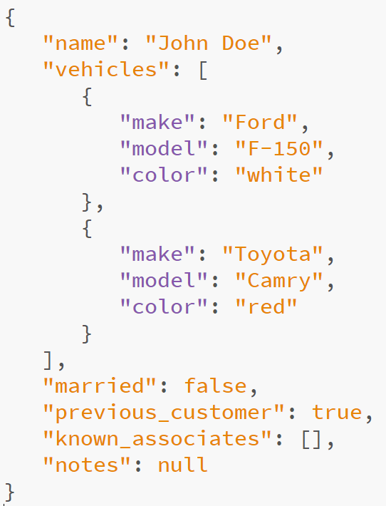
Example:

Slide 7
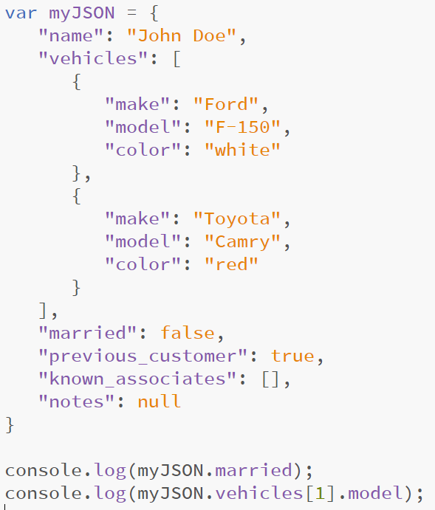
What does the console display?

Slide 8
vehicles[0]
vehicles[1]
false
camry

Slide 9
Getting Data Externally
Many times we want to use data from other servers
JSONP (JSON With Padding)
Adds a script element into the page, which loads JSON data from another server

Slide 10
Finding data
First, you must find the data
You can search for them online
Websites will allow you to request data on “Developer Mode”
Provides an API Key

Slide 11
API
Application Programming Interface (API)
Set of functions and procedures
Enable applications to access:
Operating Systems
Other Applications
Other Services
API Key
Unique Identifier
Authenticates the developer
Keeps track of calls and uses of the data

Slide 12
How to obtain an API key?
You must sign up for the website that provides the data.
Example:
https://openweathermap.org/api
Signing up provides an API key
Several Data Collections are available.

Slide 13
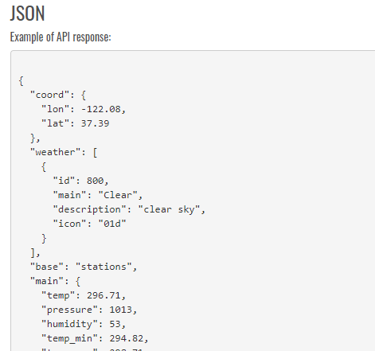
API Documentation
https://openweathermap.org/current
The documentation page explain how to call an API within your program.
For example, on openweathermap, we can provide several parameters
The data collection provides a JSON response with several pieces of data.

Slide 14
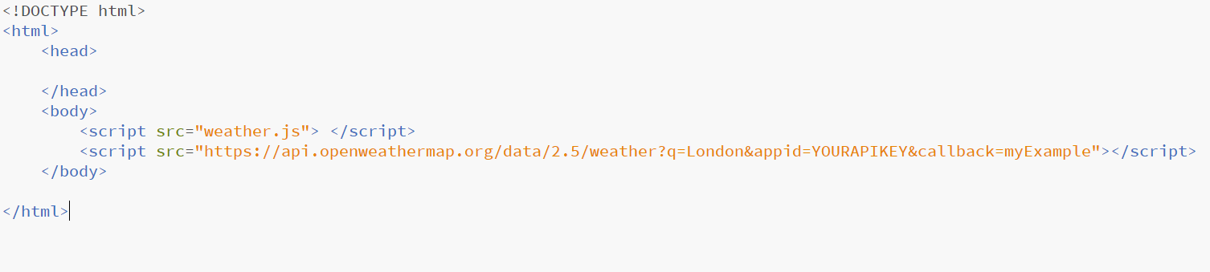
Utilizing JSONP
Your page must include a function to process the JSON data.
Your page requests the data from the server using a <script> element

Slide 15
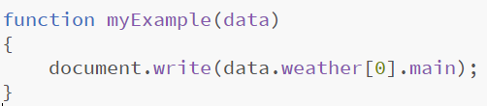
weather.js

Slide 16
API Request URL
Your API key. It’s called appid for this specific API
Indicates a city q = city
This is determined by the API, we must find this information on their documentation
Allows us to process the data through a function called myExample. myExample could be changed to be any name you prefer
Website call

